Slide 1

Vector Graphics Complexes
The 41st International
Conference and Exhibition
On Computer Graphics and
Interactive Techniques
Boris DalsteiN
Rémi Ronfard
Michiel van de Panne
University of British Columbia
INRIA & University of Grenoble
University of British Columbia

Slide 2


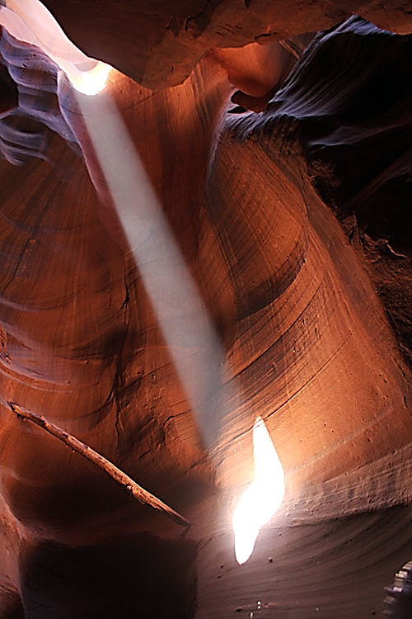
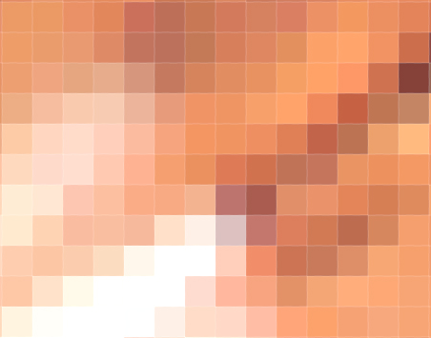
Vector Graphics
Illustration
Fonts
pixel-based
vector-based
Notes:
Let’s recall briefly what vector graphics is.
There are two approaches to represent an illustration. The first one is the pixel-based approach.
The second one is the vector-based approach, and is the subject of this talk. An image is made of mathematical primitives, such as this circle. A direct advantage is that it is resolution independent. Vector graphics is everywhere. Every logo, font, and many many illustrations are vector graphics. [00:45]

Slide 3
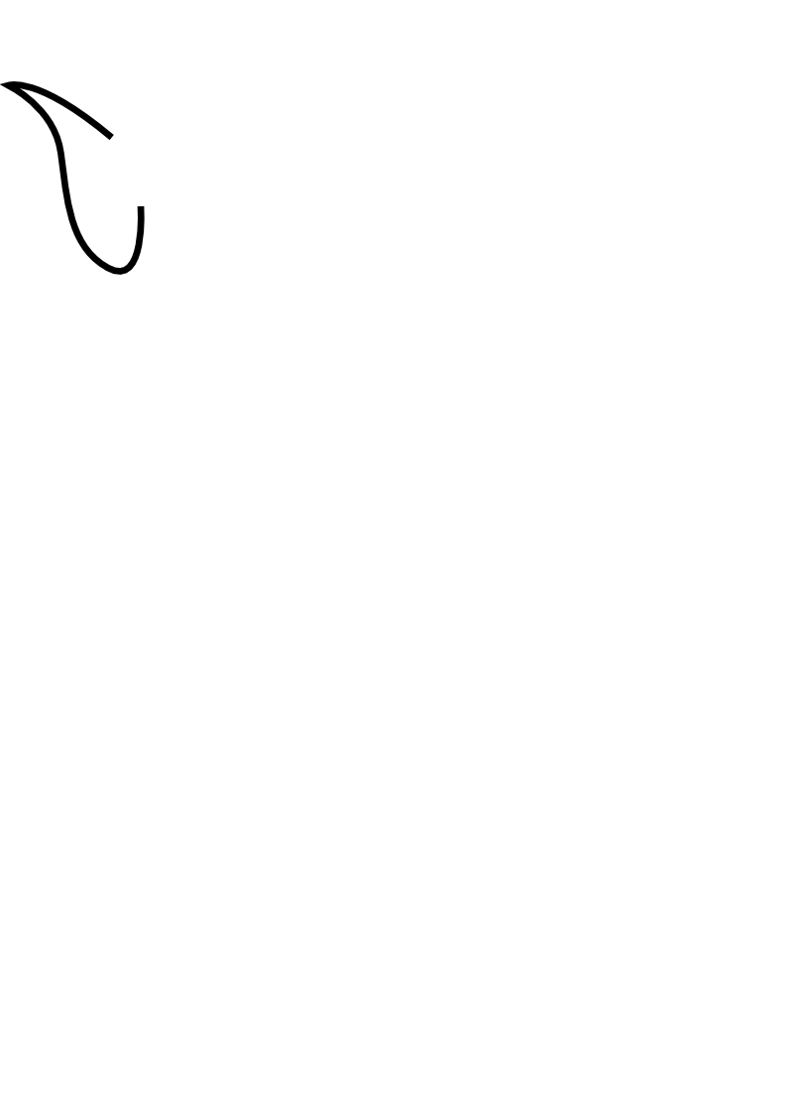
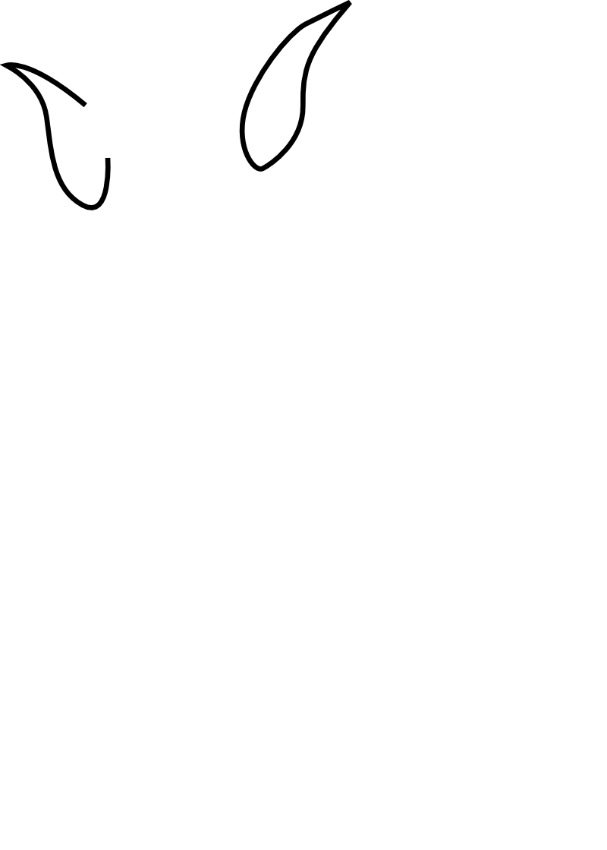
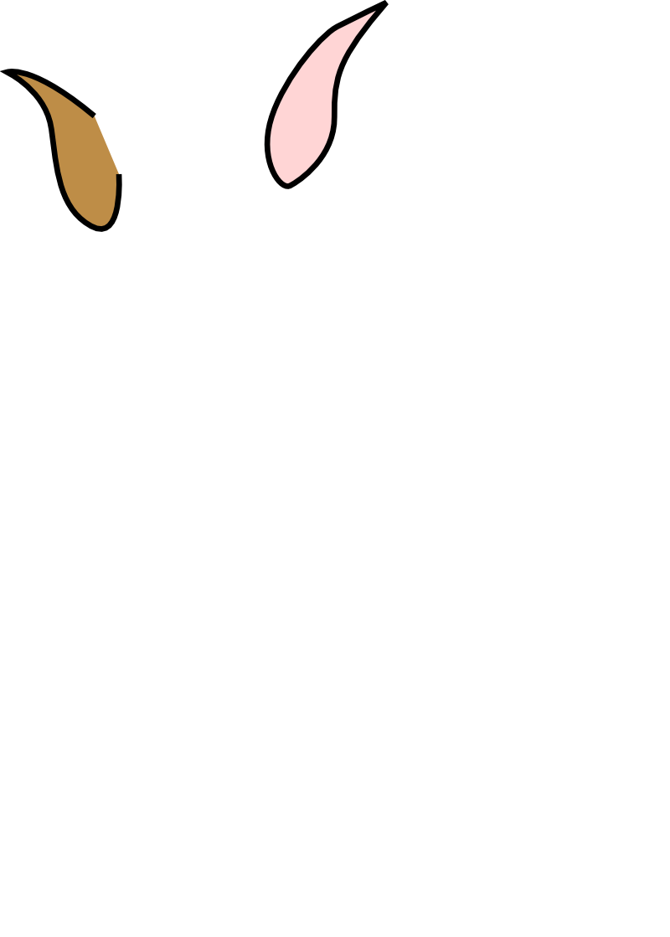
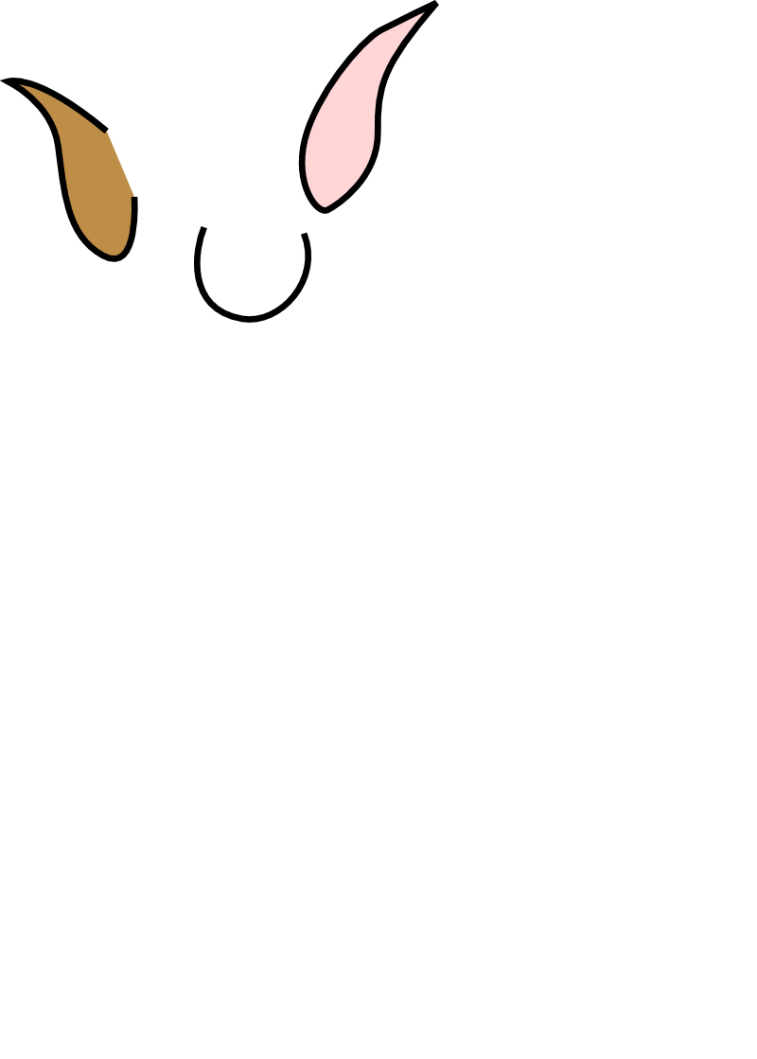


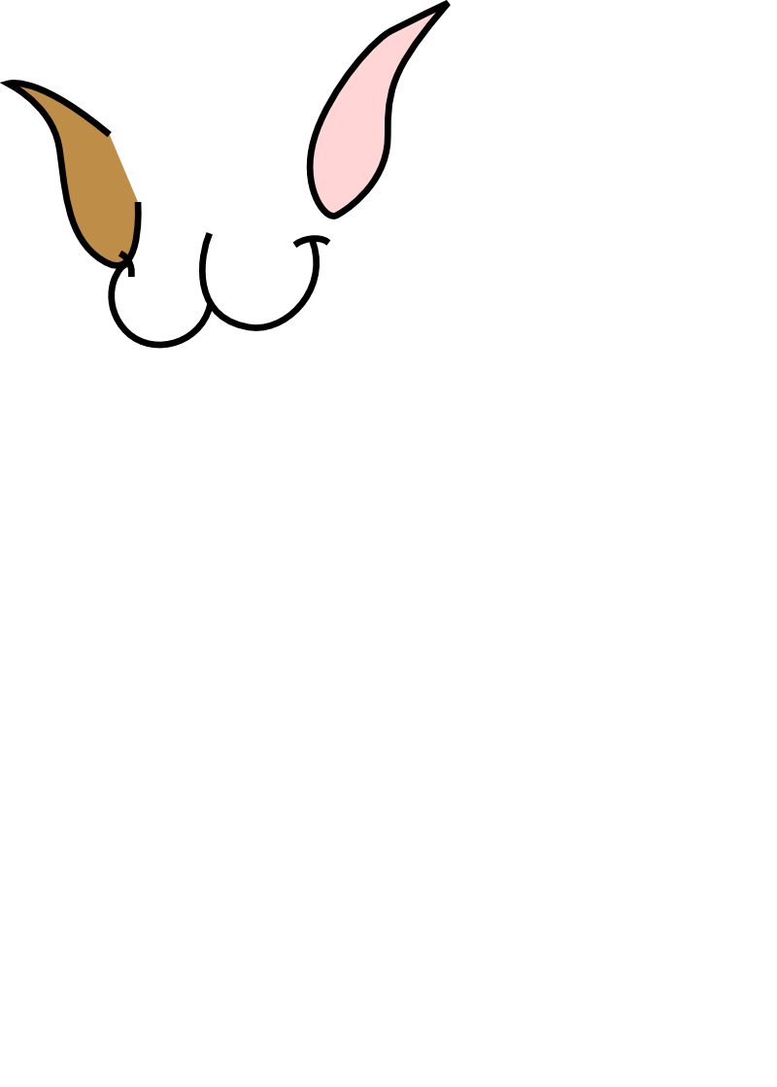
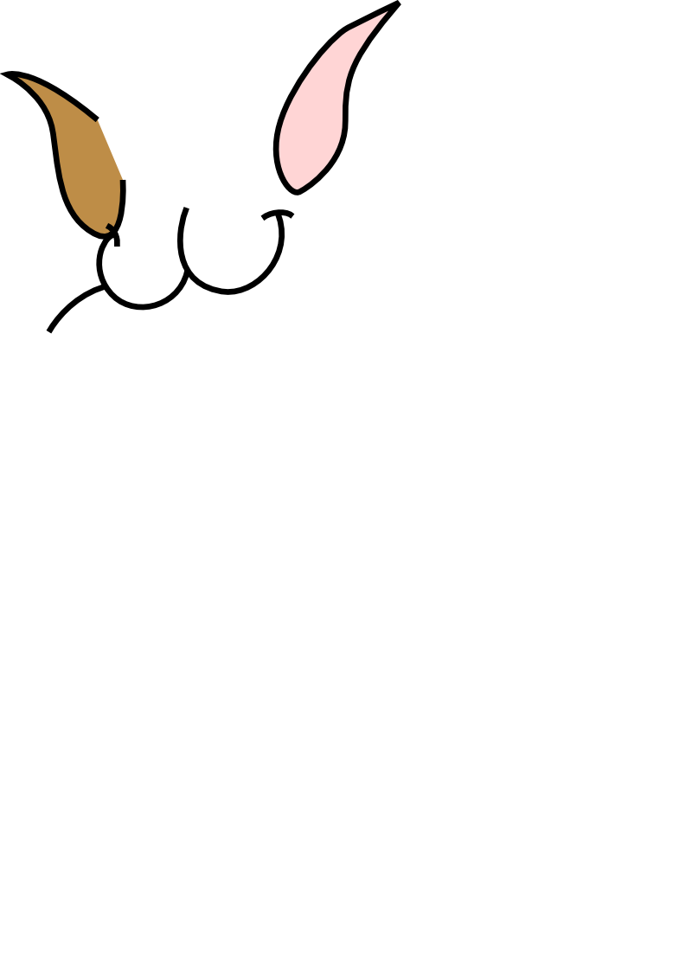

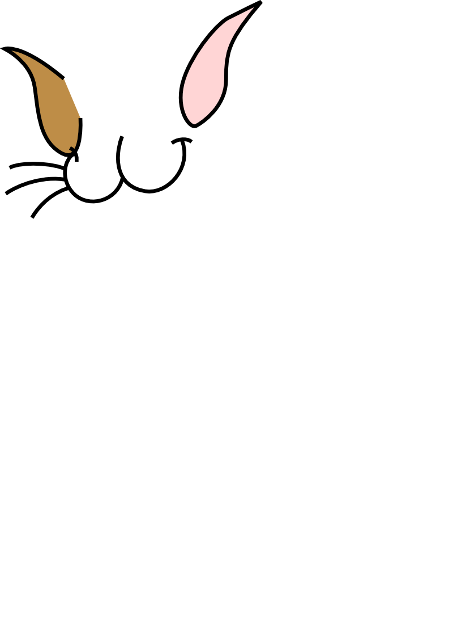
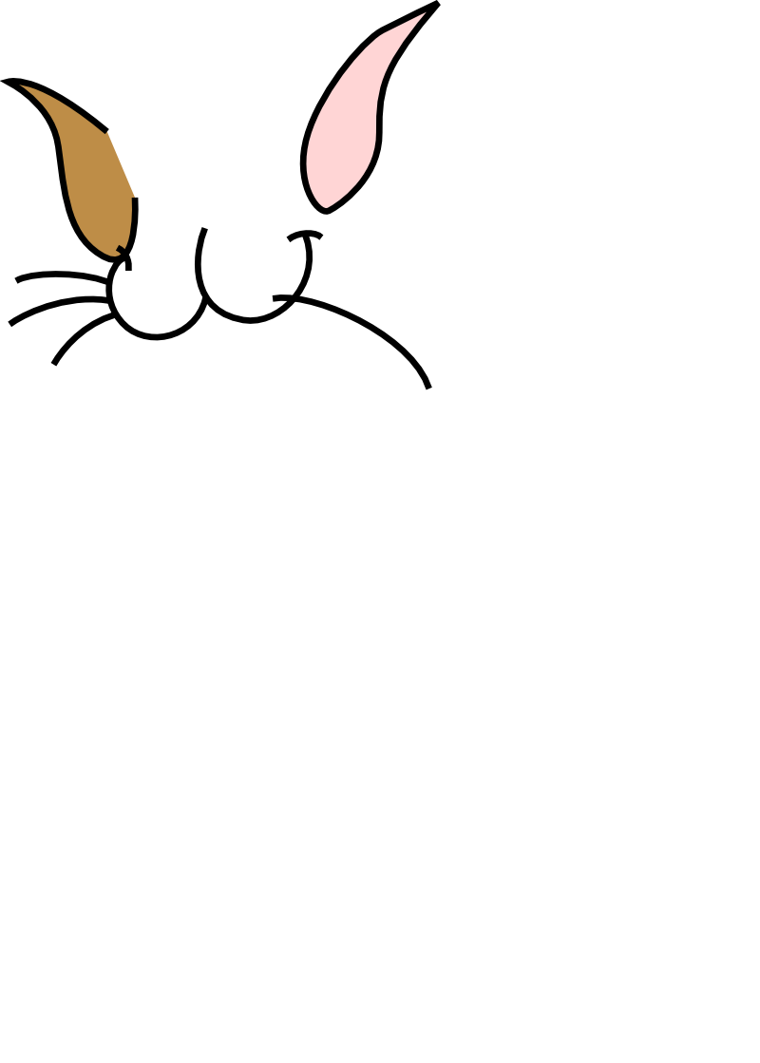
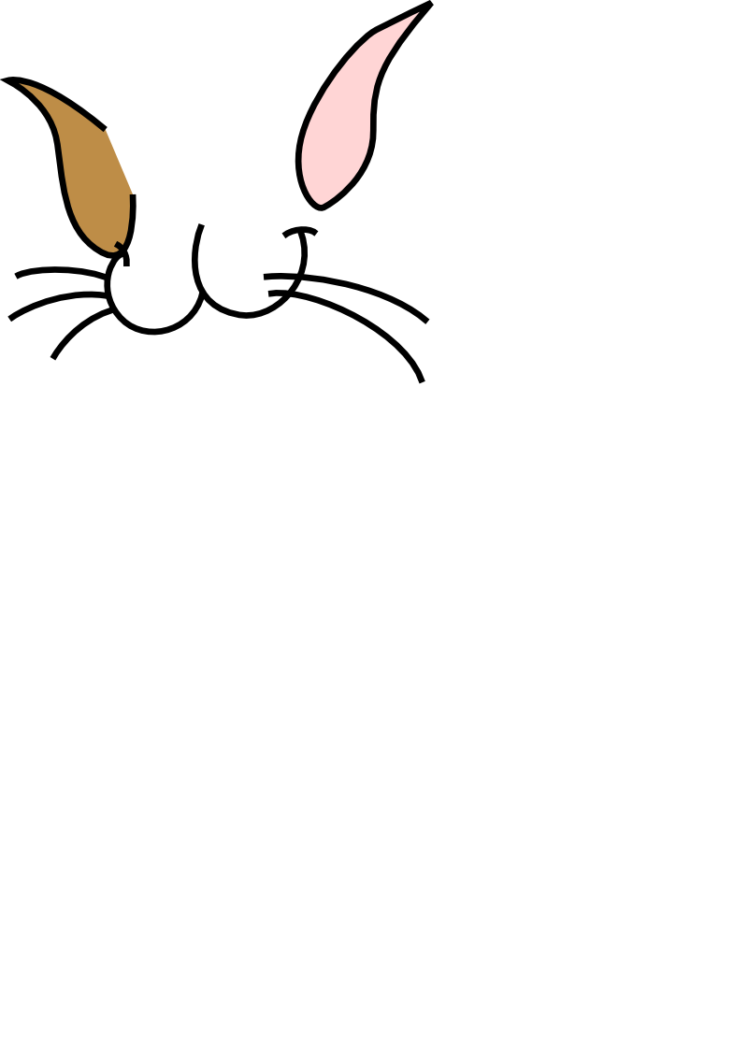
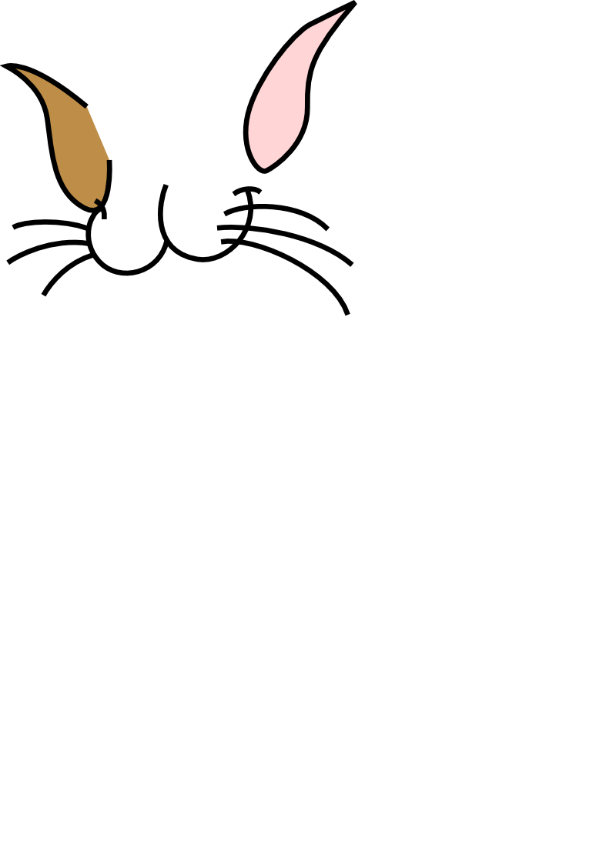
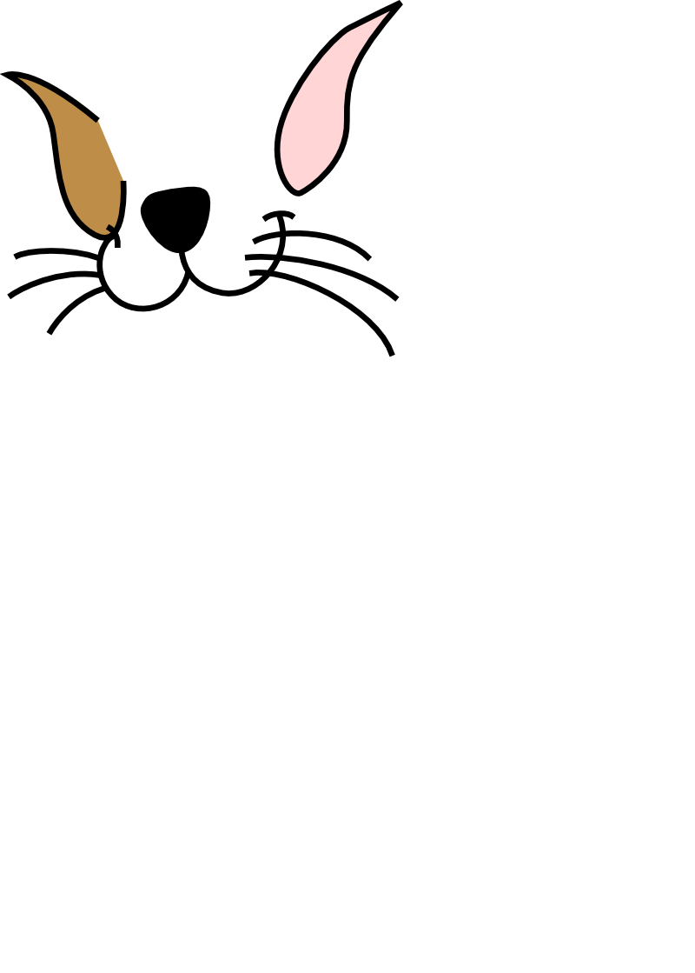




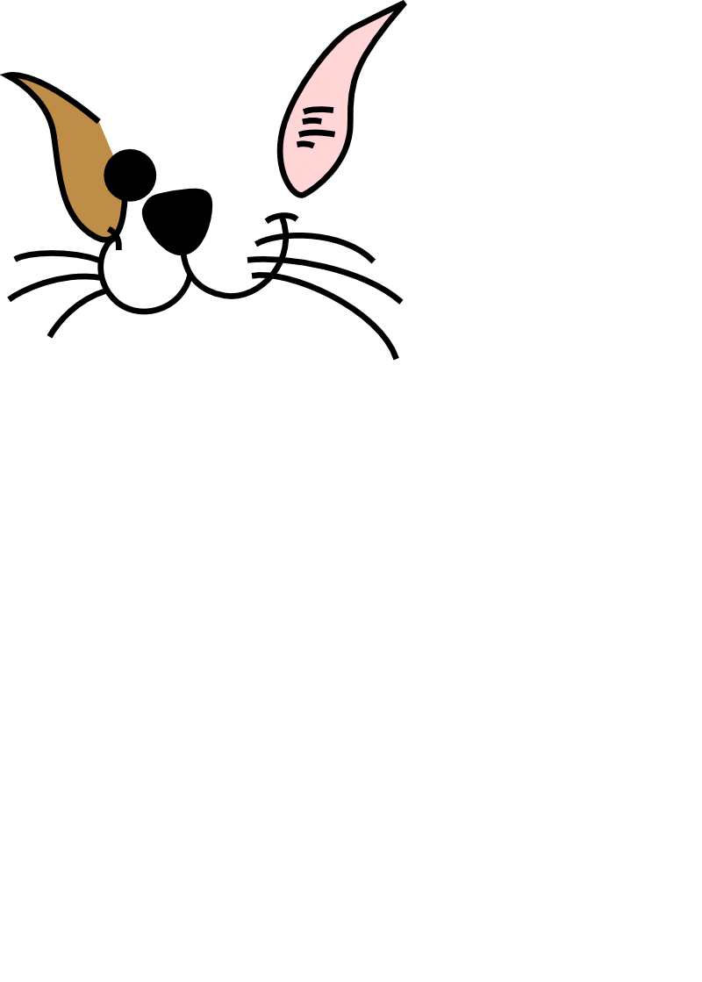
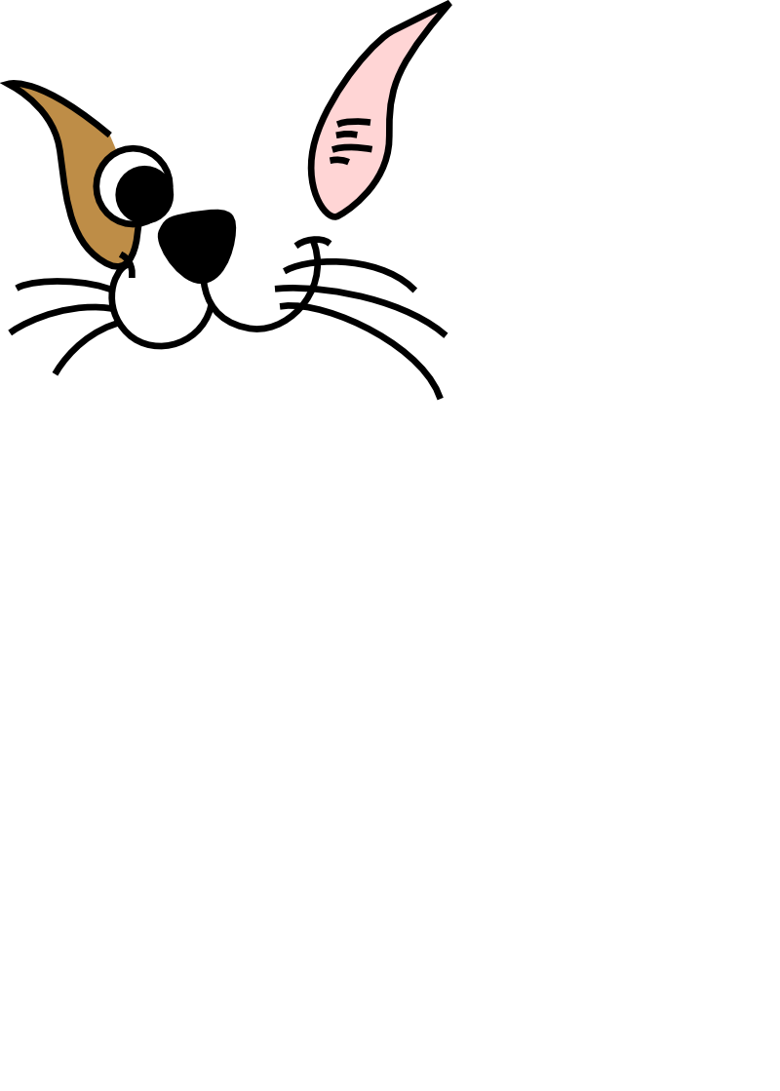
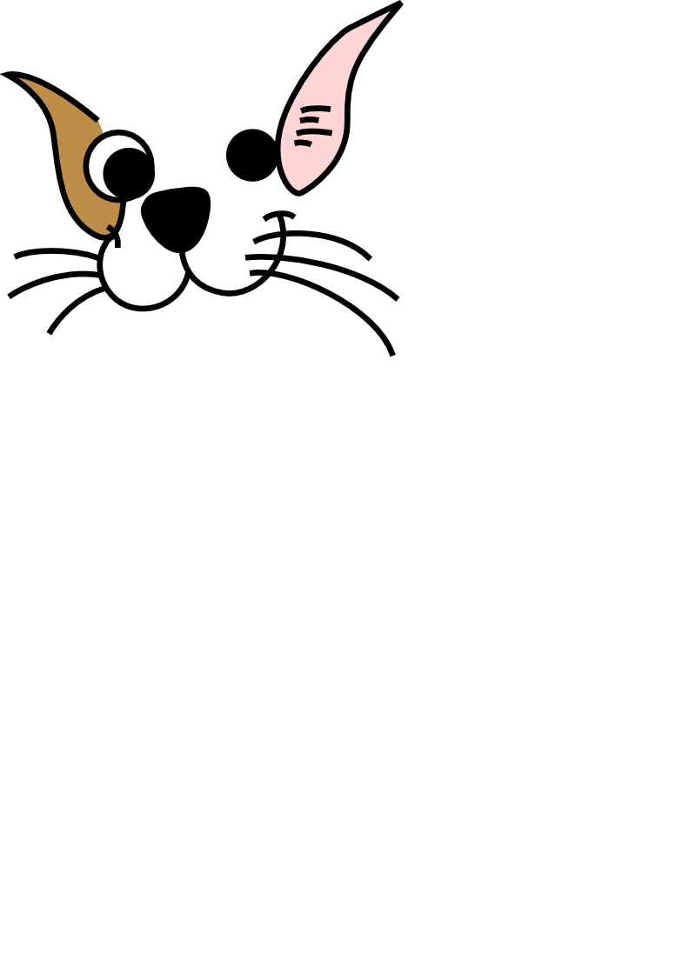
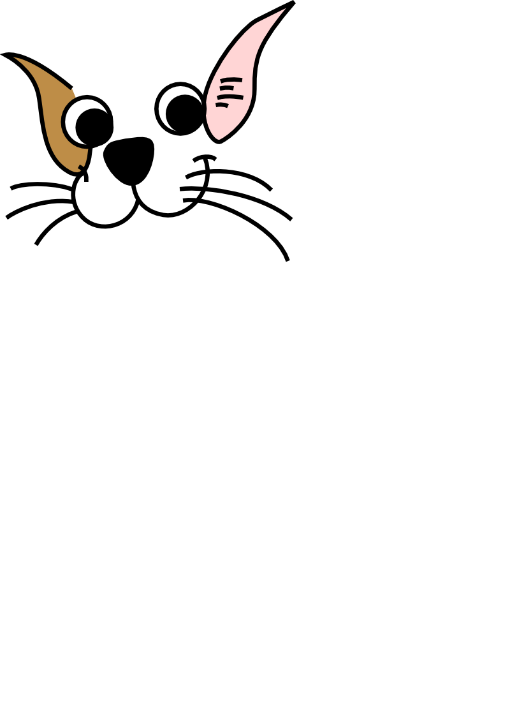
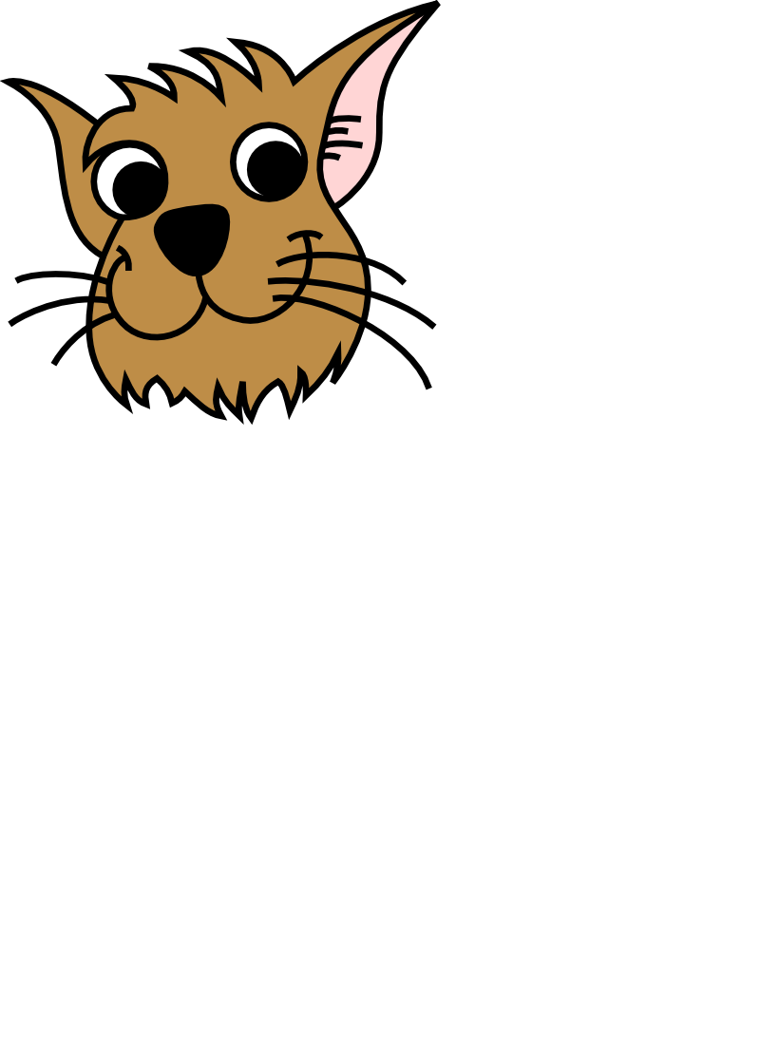
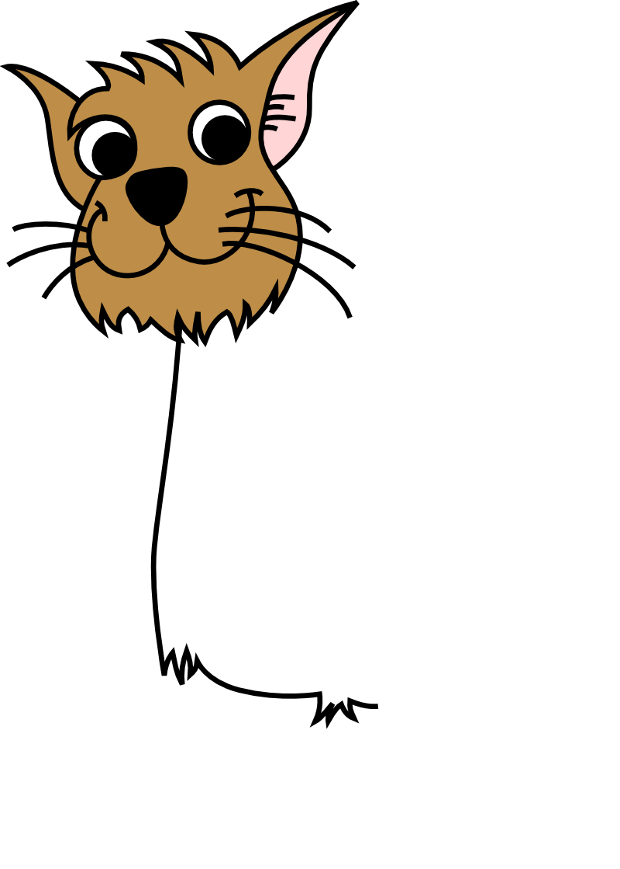
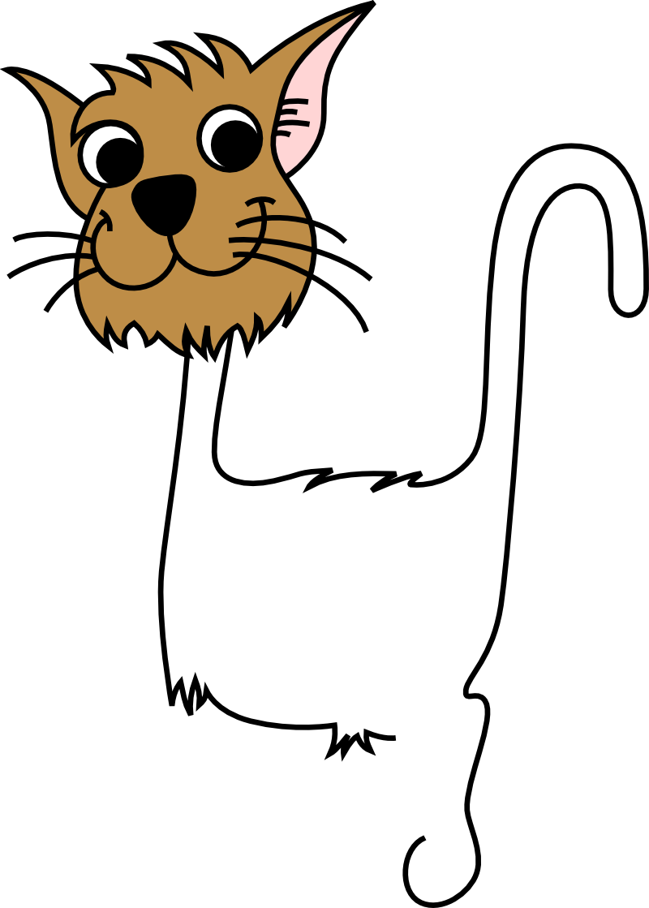
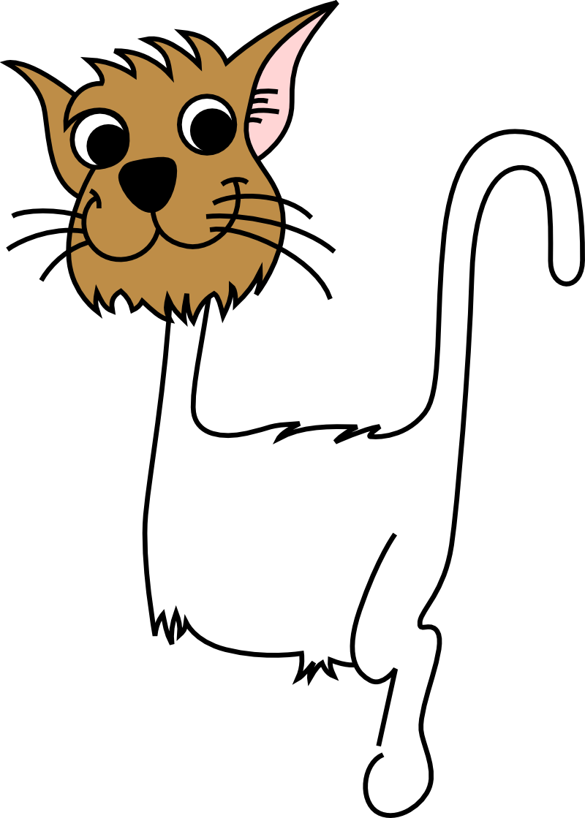

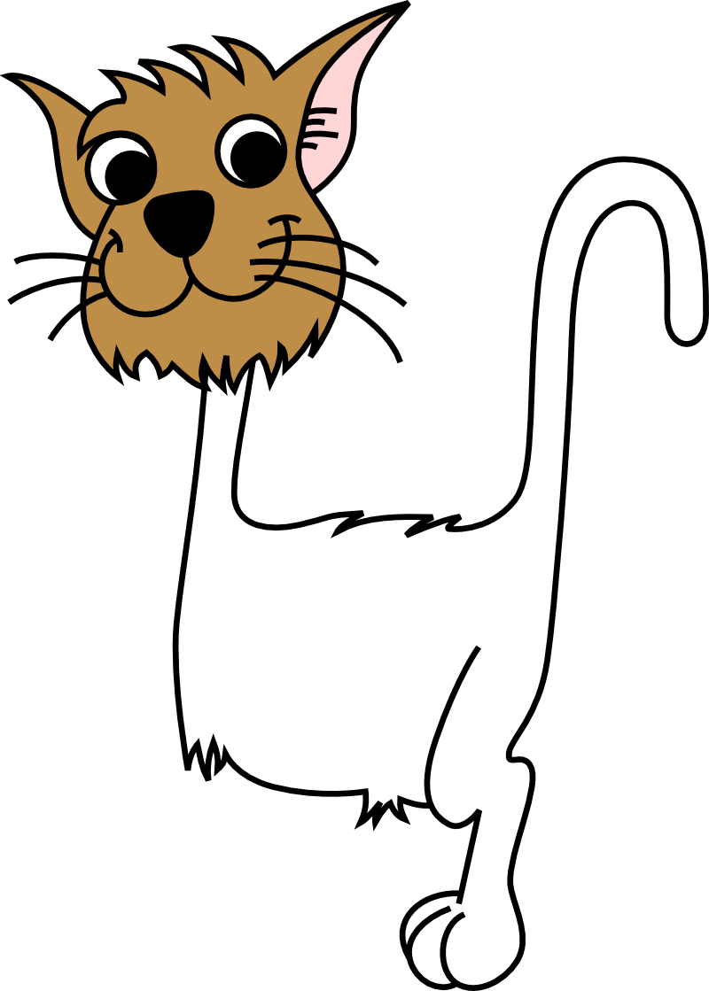
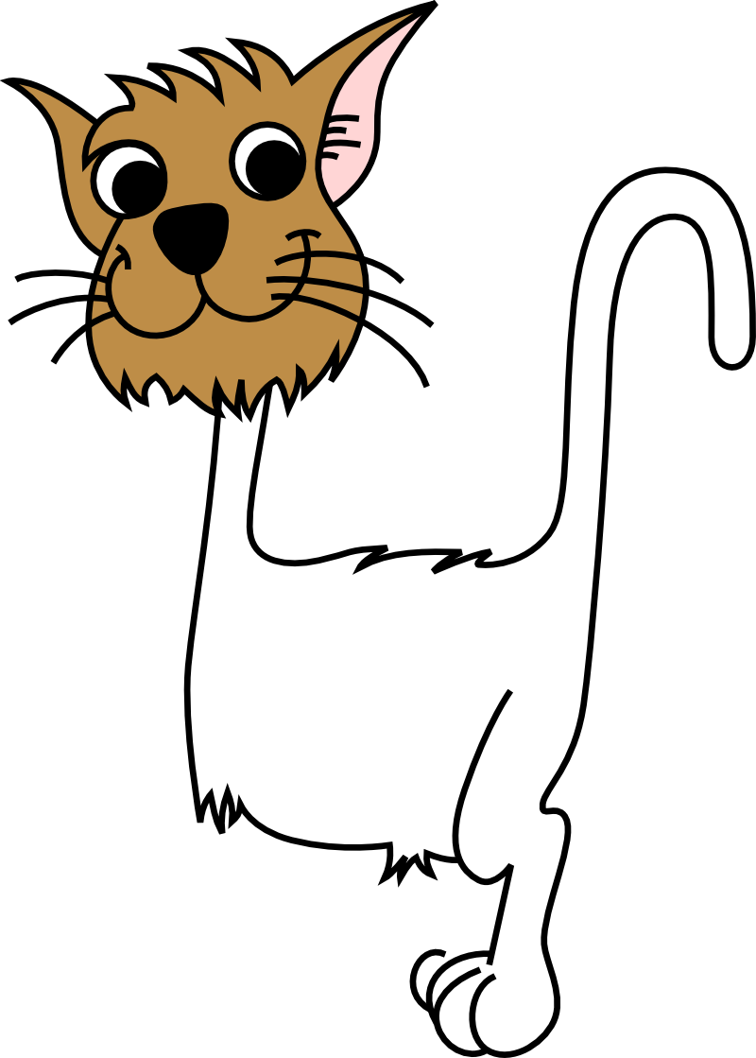

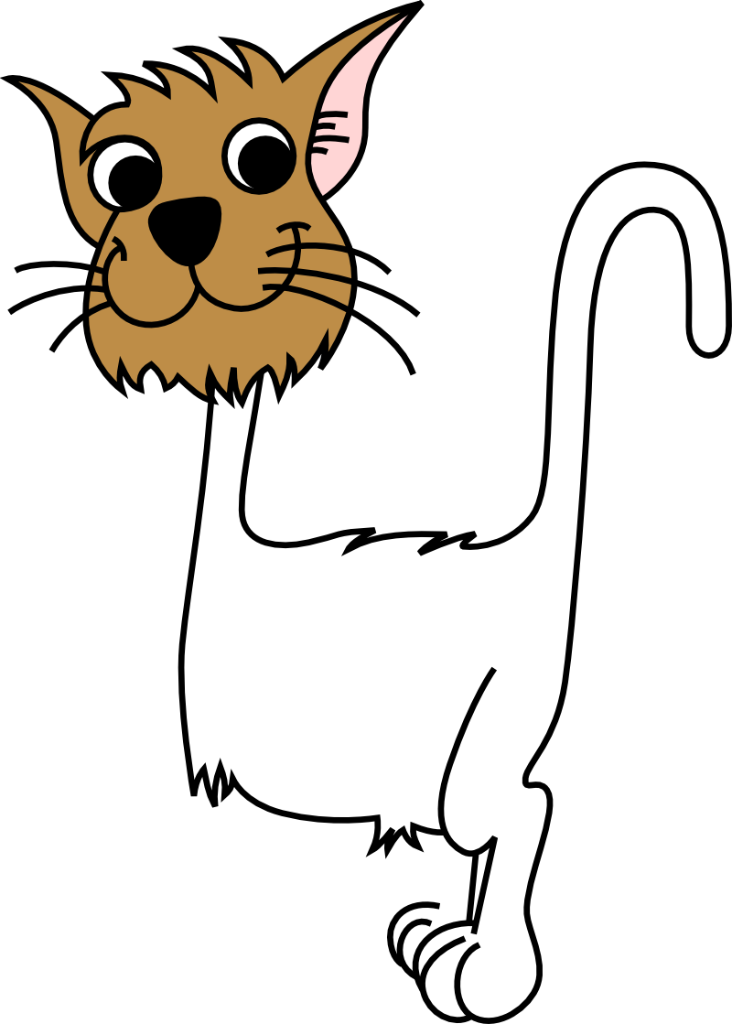

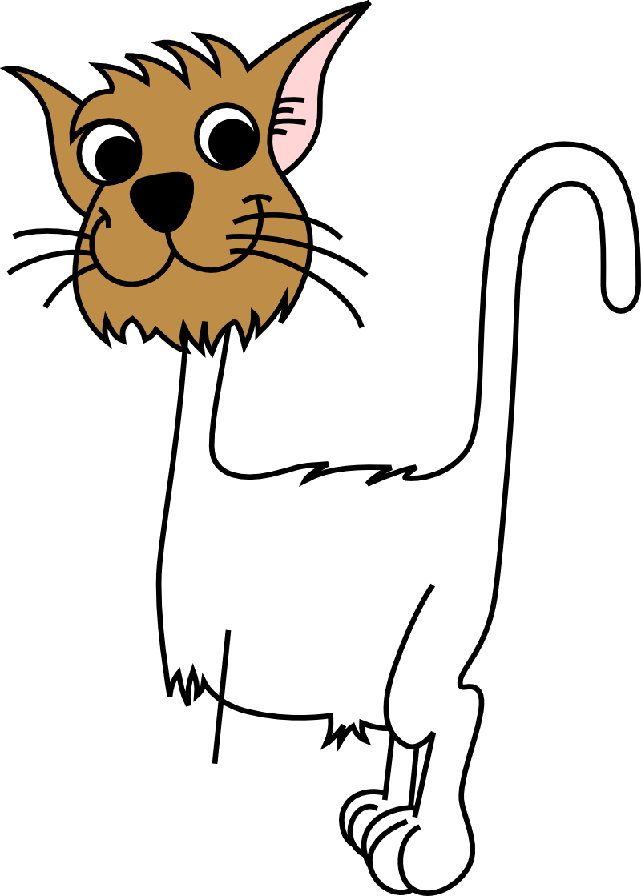
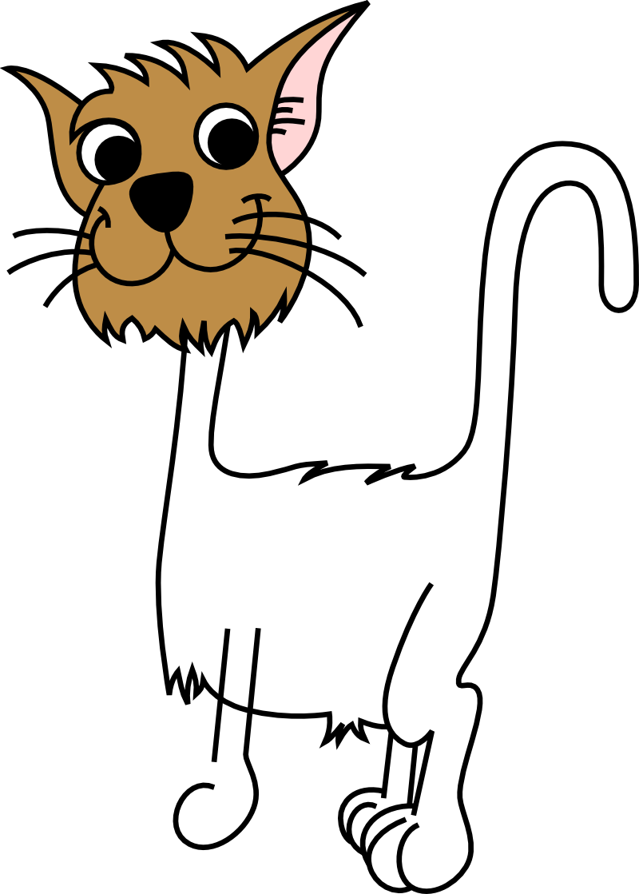
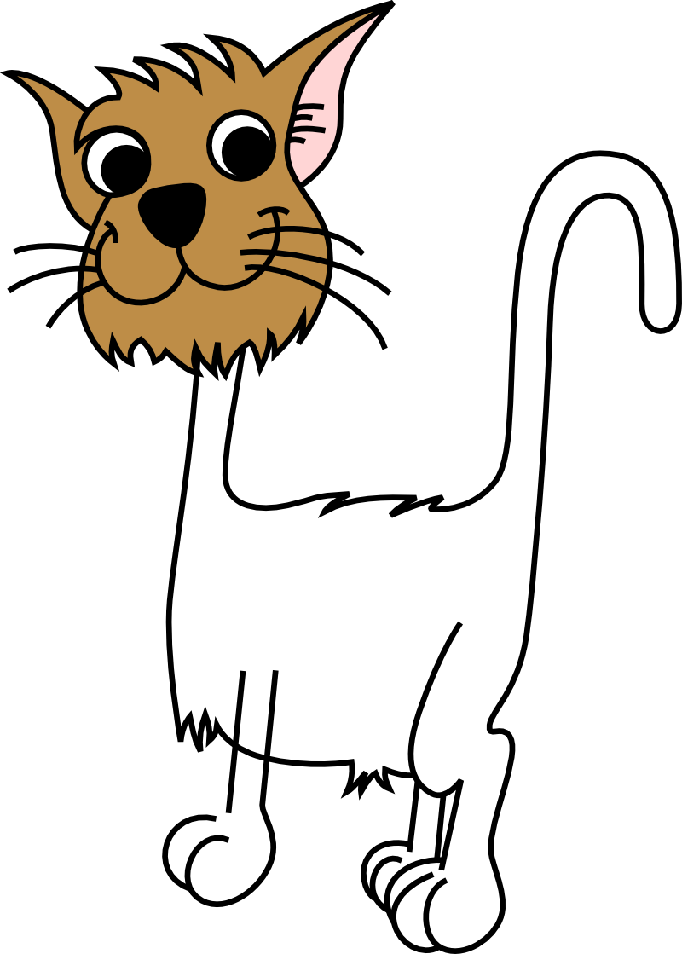
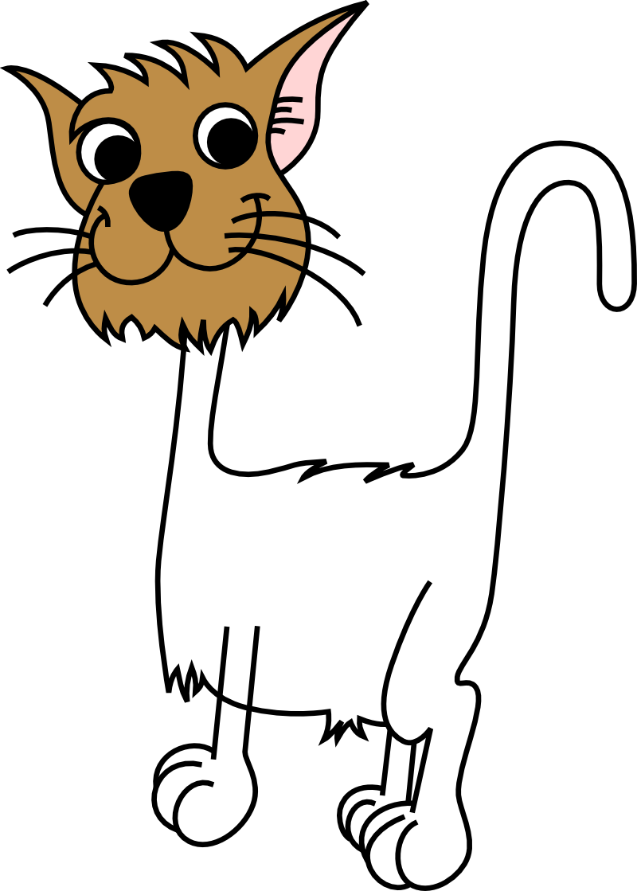
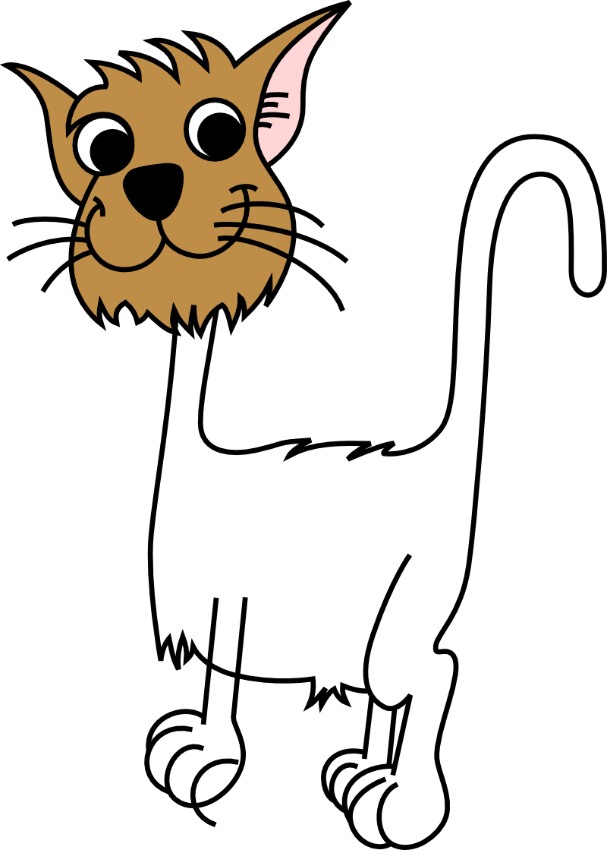

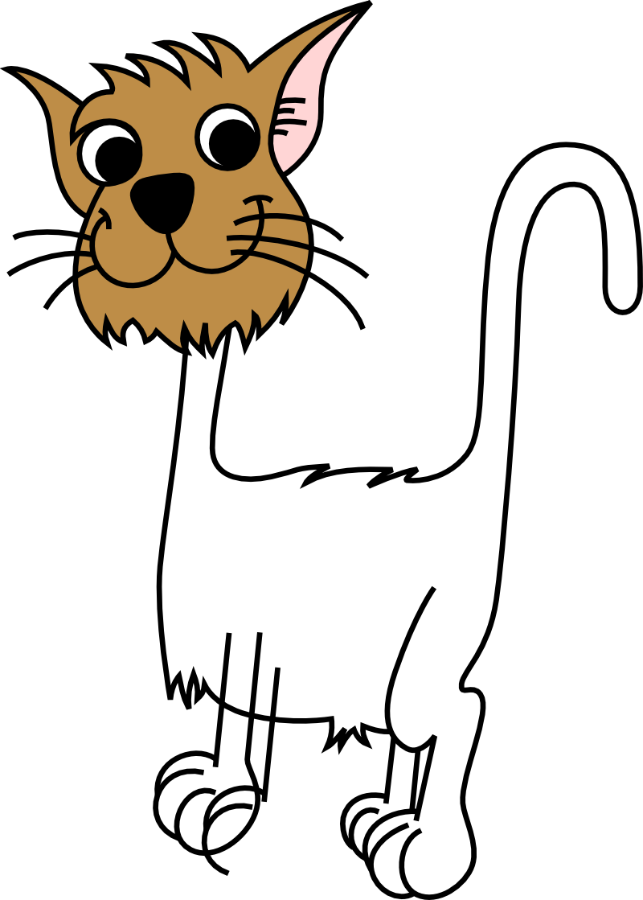
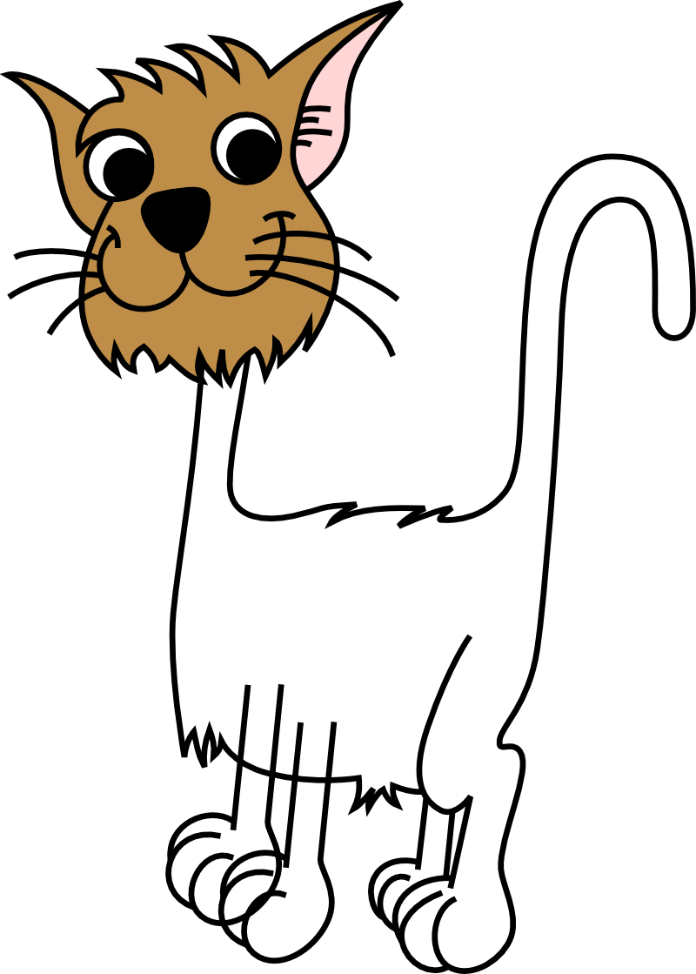
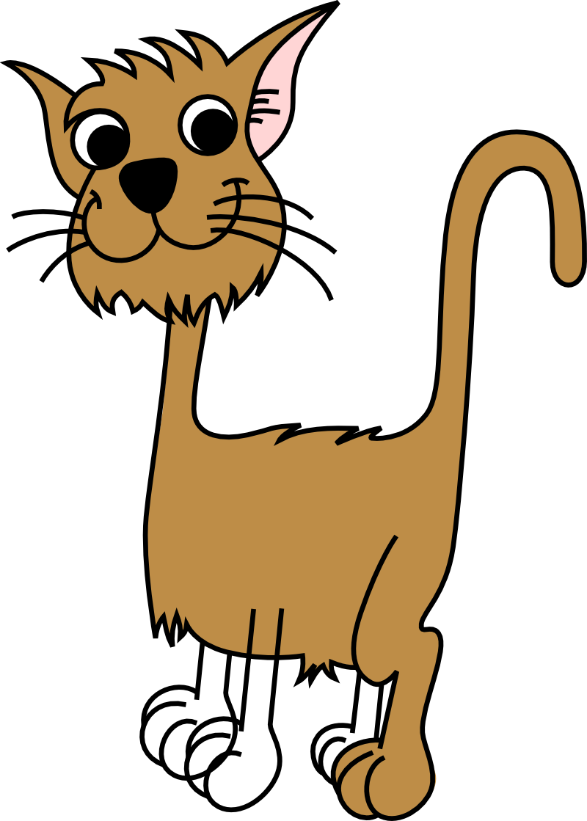
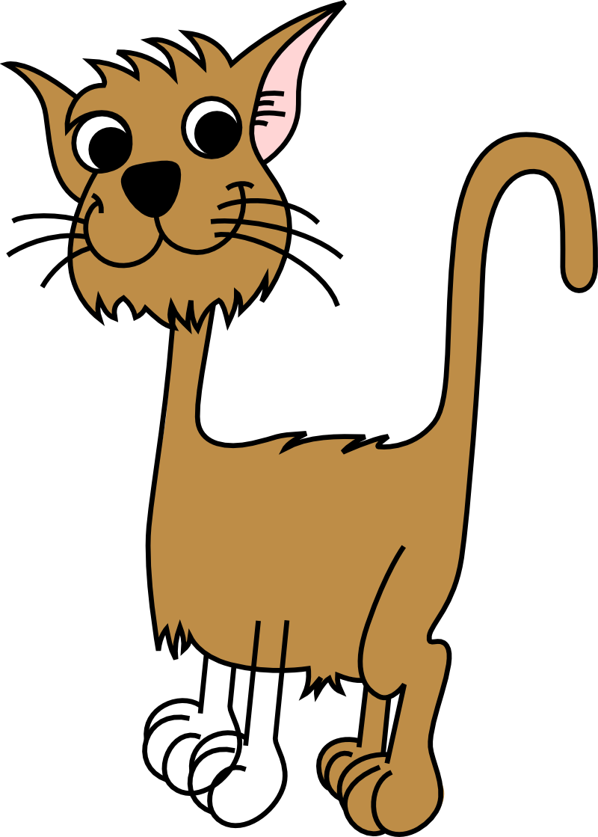
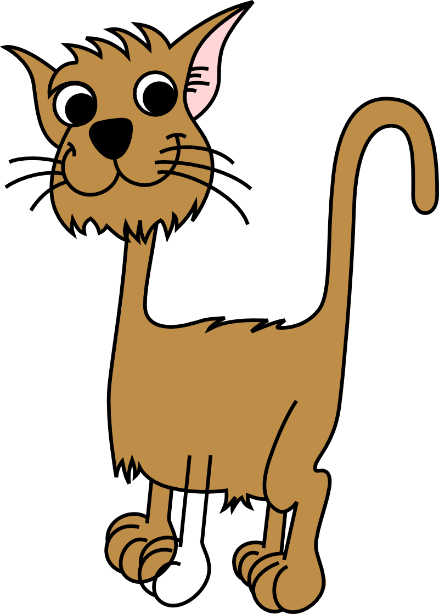
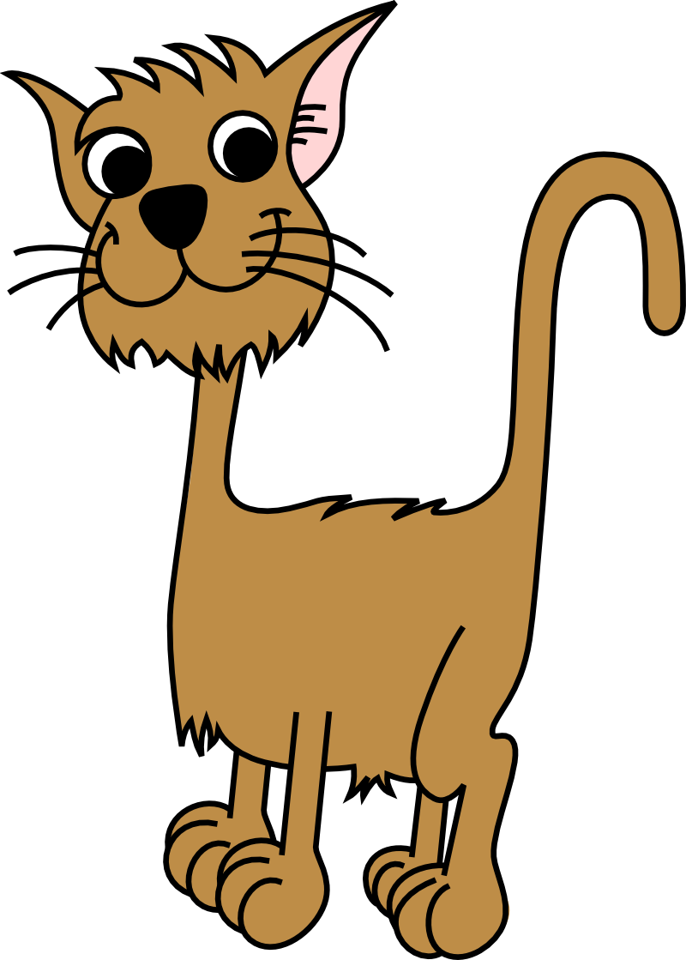
Scalable Vector Graphics (“SVG”)
Notes:
But surprisingly, most vector graphics systems today still use a traditional and very limited representation that we call SVG. It is made of open curves and closed curves, that you can optionally fill with a color, or not. By using a large number of such primitives, it is possible to create arbitrarily complex illustrations, such as this lovely cat. [01:25]

Slide 4

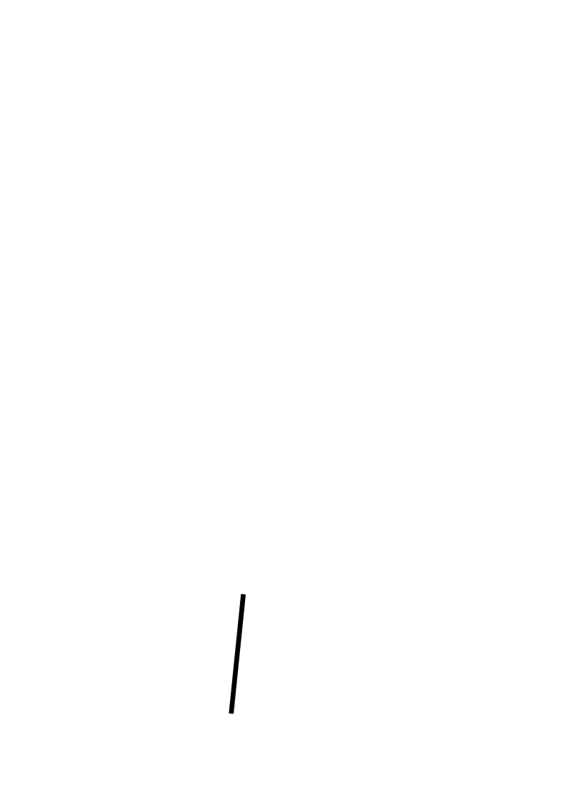
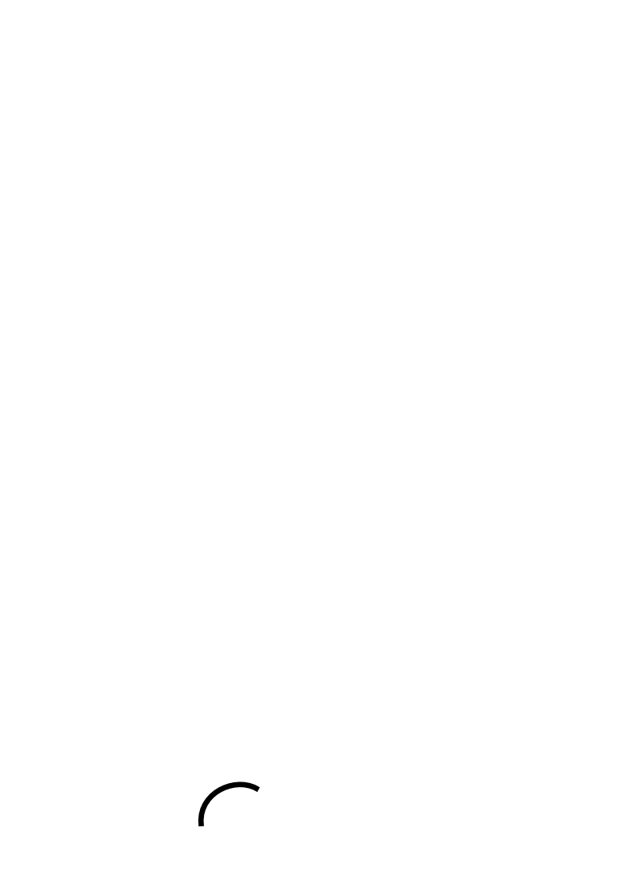
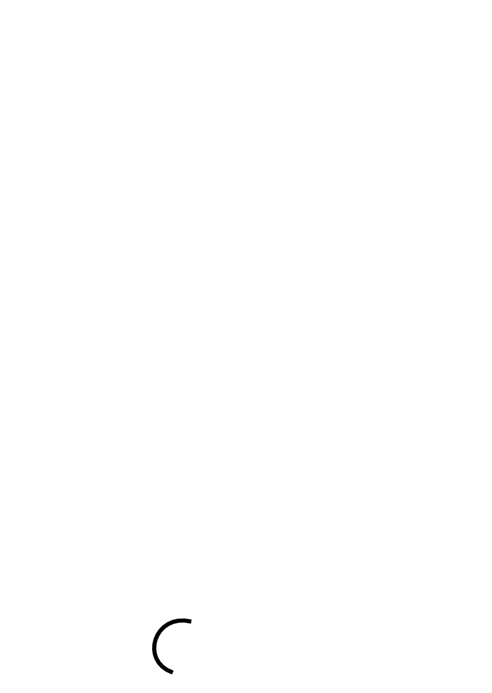
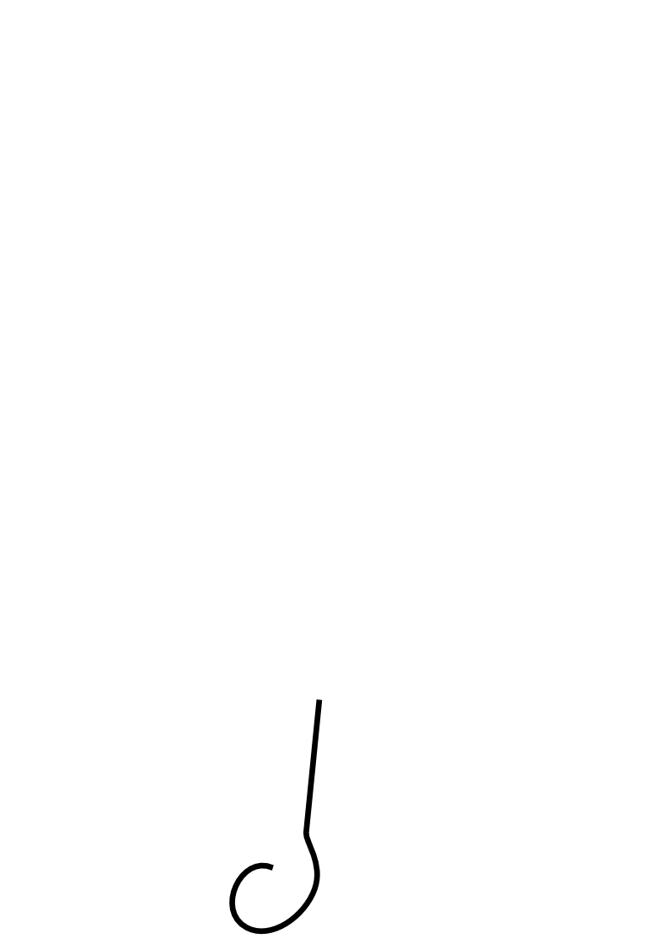
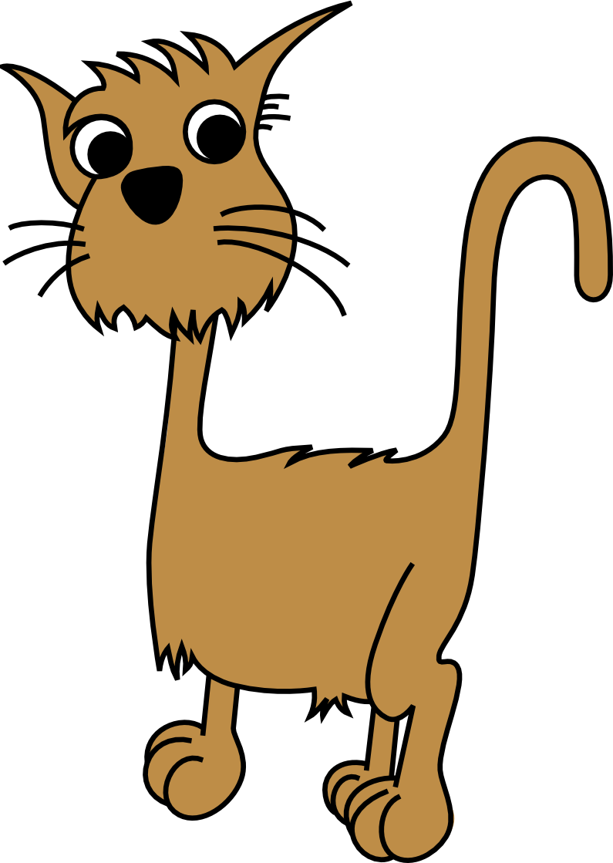
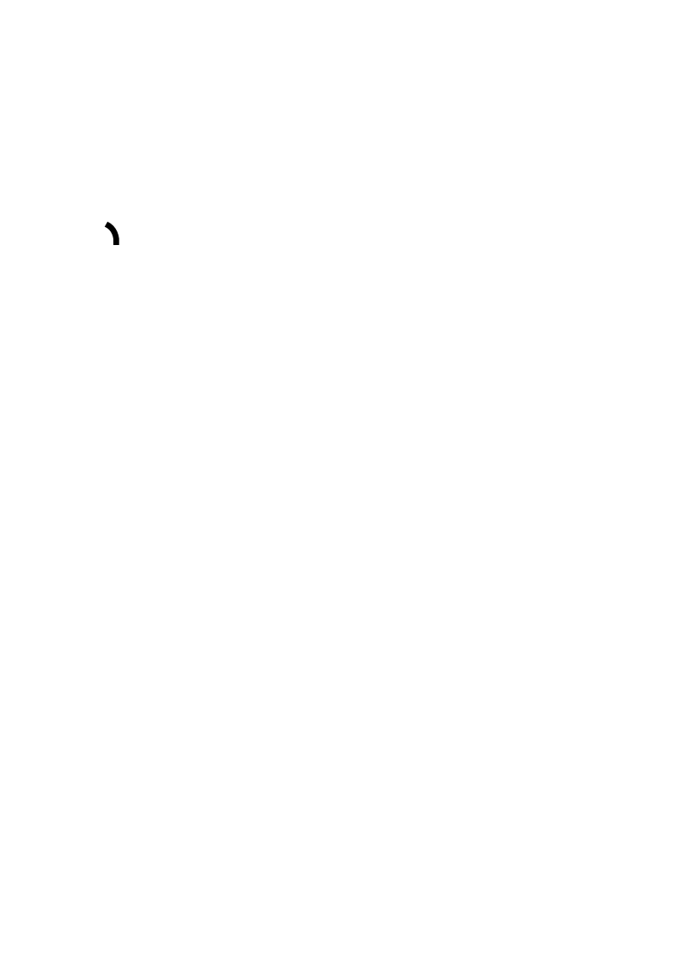
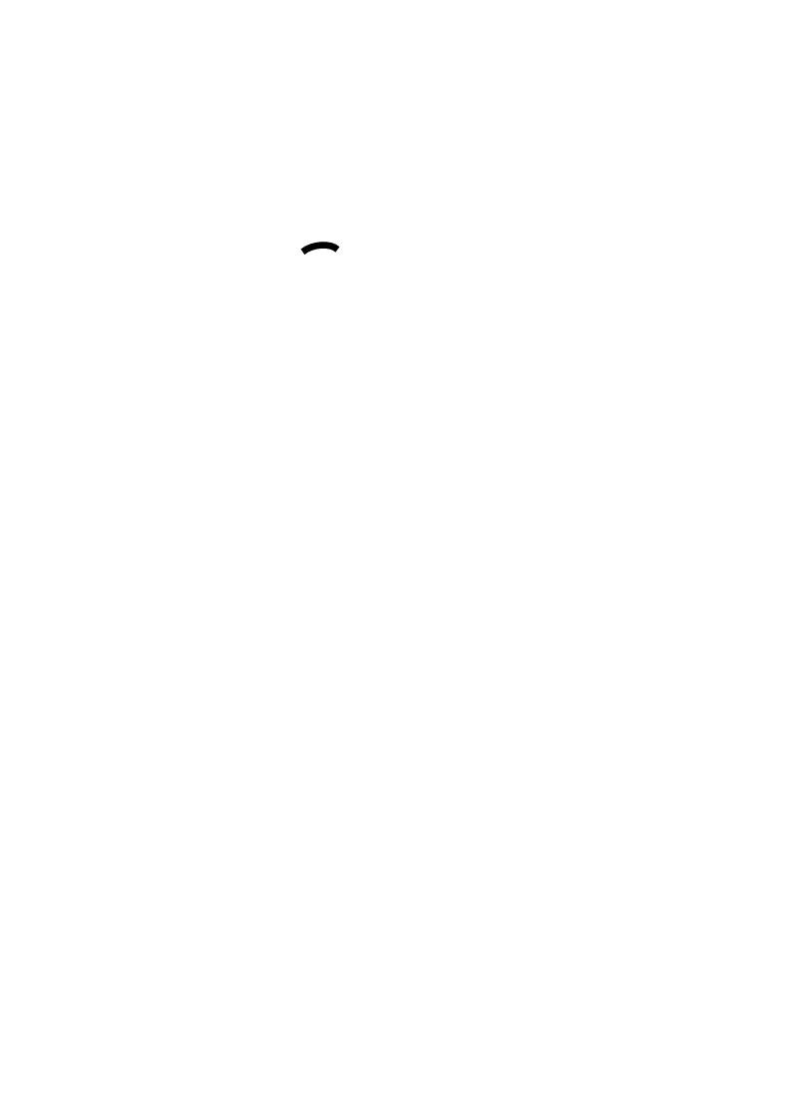
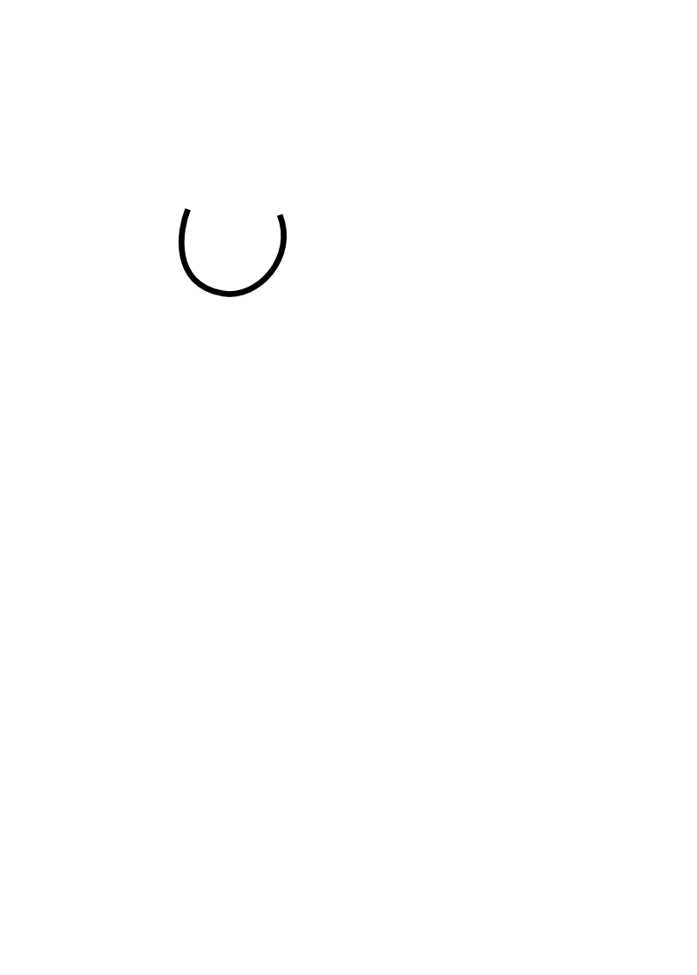
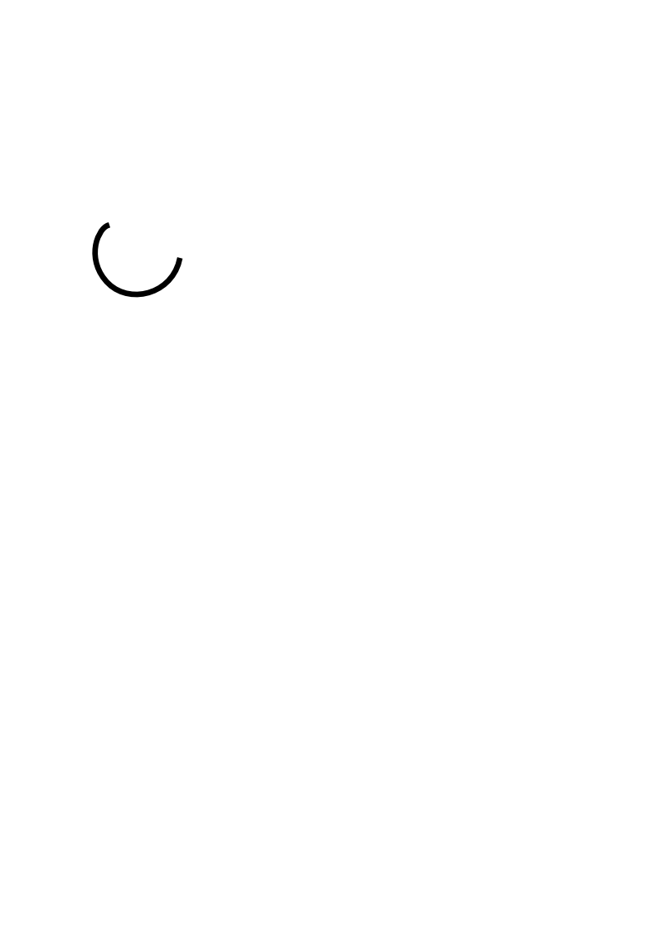
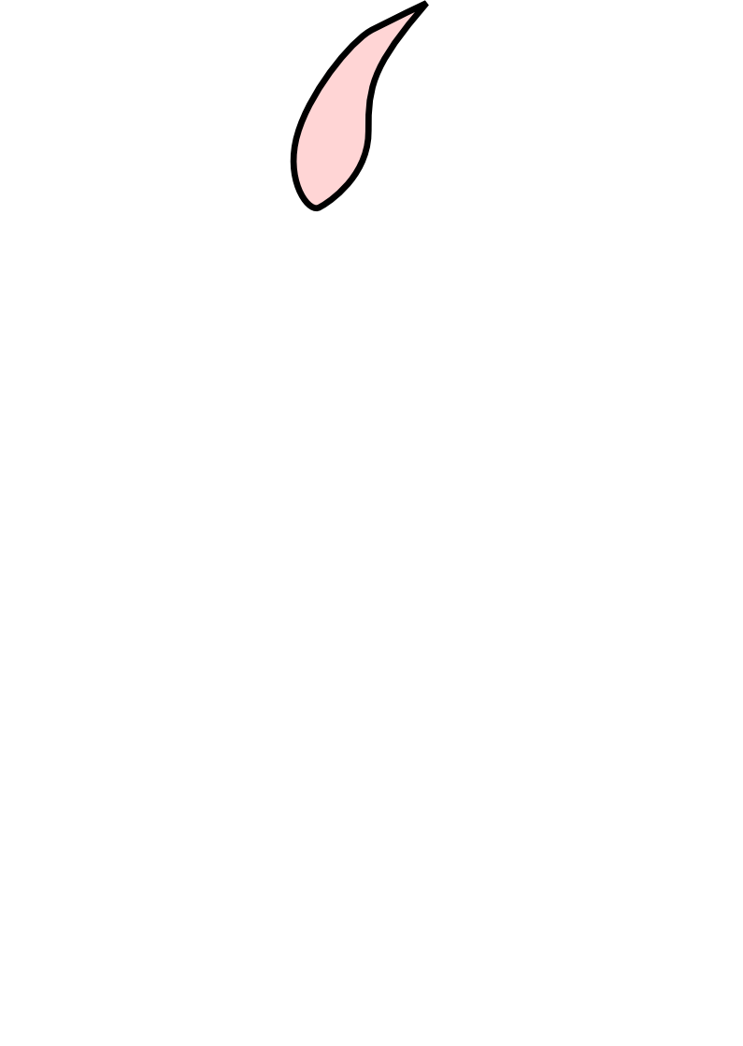
Scalable Vector Graphics (“SVG”)
  No shared edges
  No multiway joins
Notes:
We now explain why this representation is very limited. It does not truly support shared edges, and therefore they must be faked using independent objects. Also, it does not truly support multiway joins, and they must be faked as well using independent objects. As a consequence, these 3-way joins must be represented with independent curves, which forces the artist to create the fill color as yet another independent object. [01:45]

Slide 5

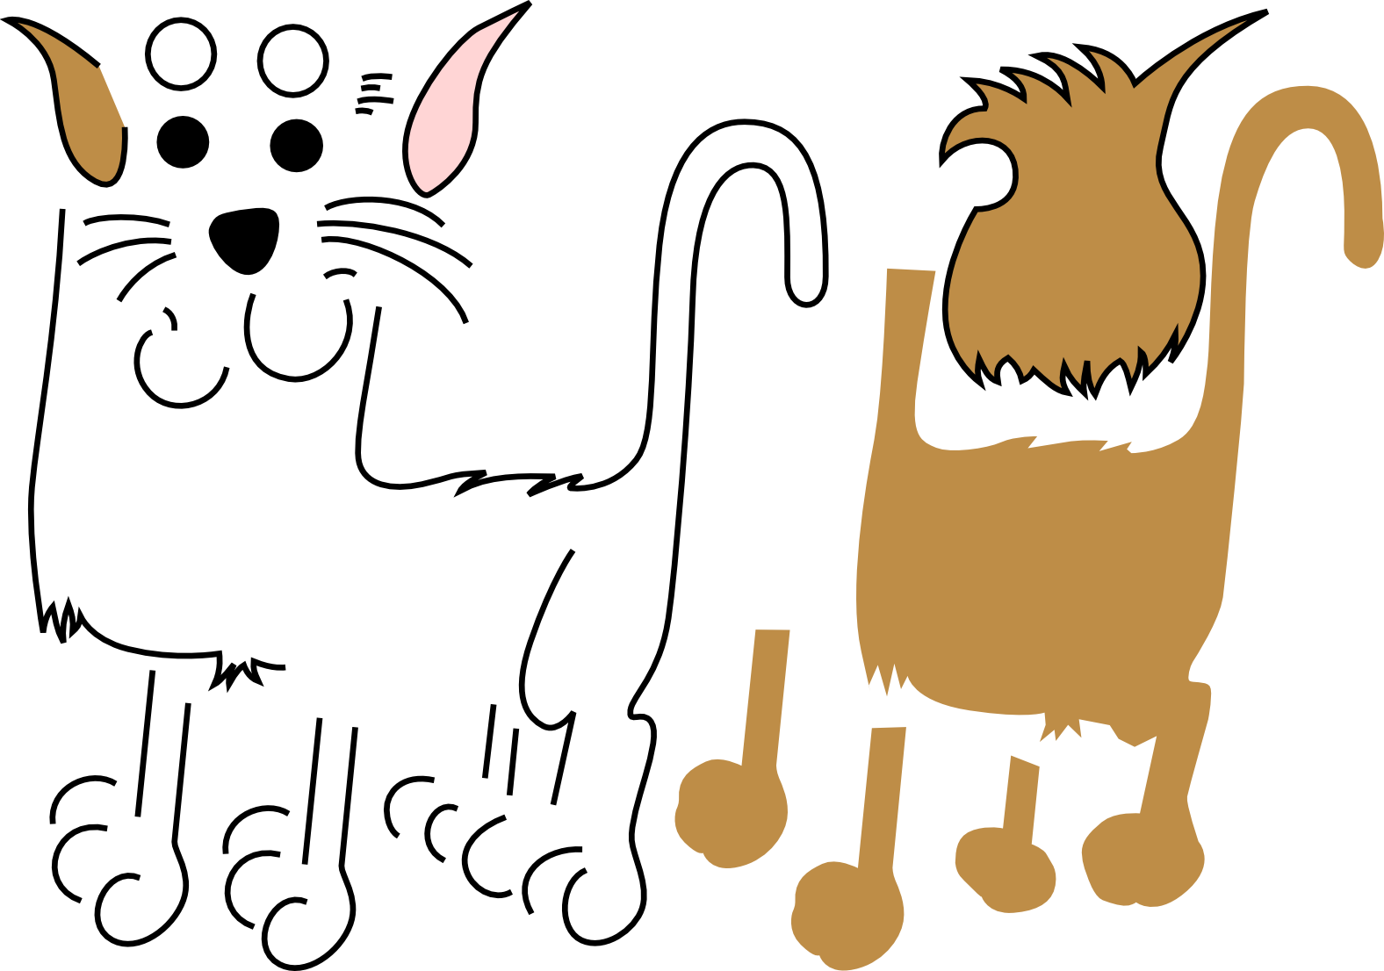
Scalable vector graphics (“SVG”)
Notes:
In total, this simple cat must be represented with 43 independent objects, including some redundant geometry, which makes editing or animating the cat a real nightmare. What is missing is a good model representing the topology of the drawing. [02:05]

Slide 6
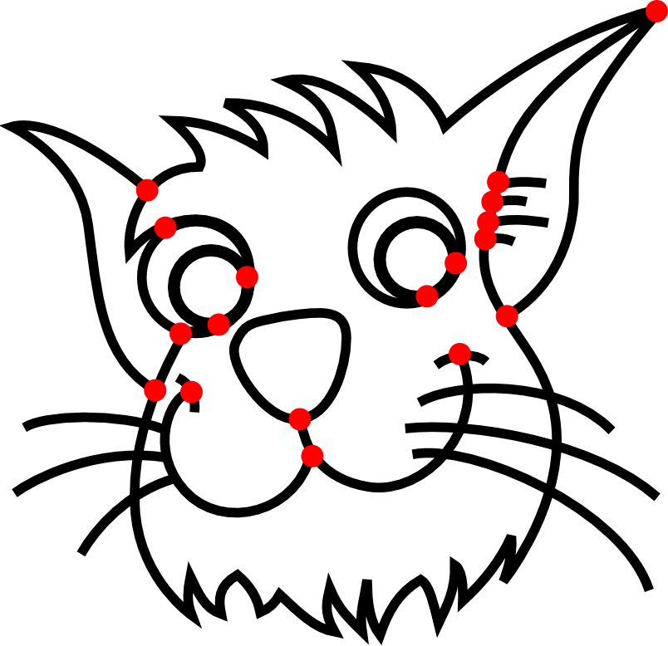
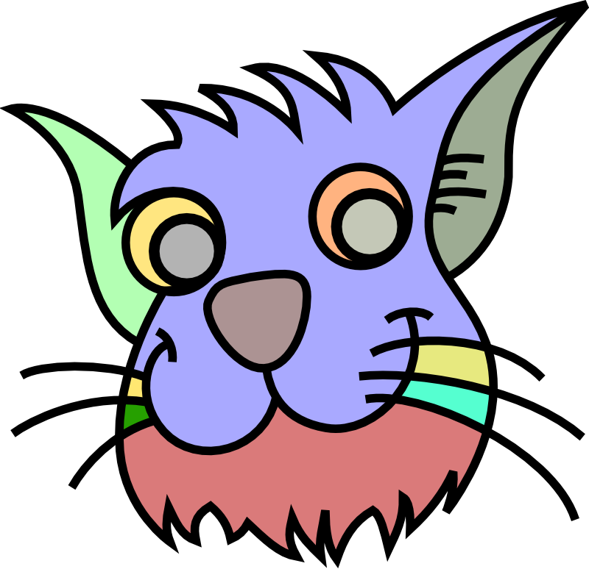
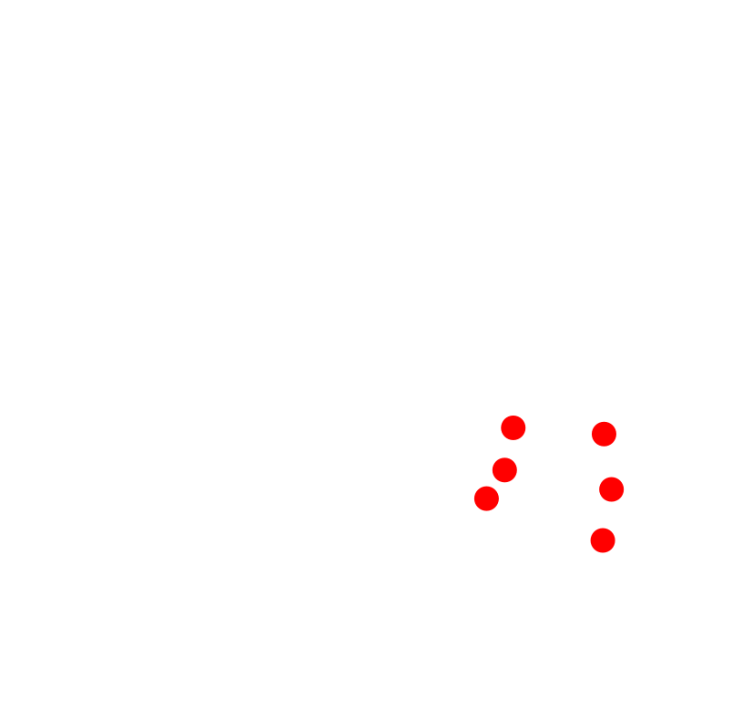
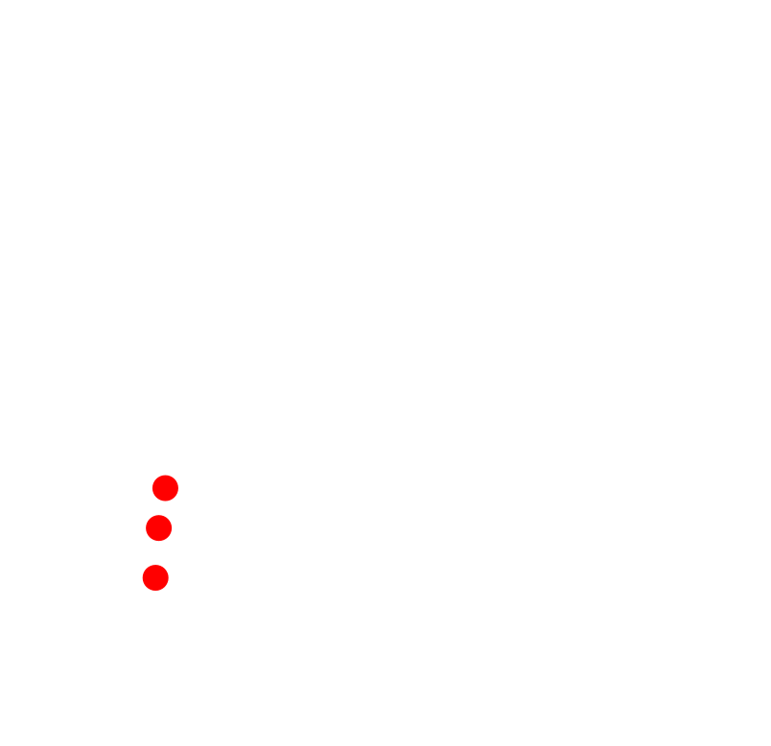



Planar maps
[Baudelaire et al. 1989] [Asente et al. 2007]
  No overlapping
Notes:
One simple way to represent the topology is called planar maps. Given as input a set of curves, we can compute their intersections, which define a partition of the canvas into disjoint faces. This is a planar map. It is able to represent multiway joins, as well as shared edges. However, it introduces unwanted faces, caused by unwanted intersections. In this case, we would rather connect the whiskers to the interior of the face. But this is not possible, because planar maps do not support overlapping. [02:45]

Slide 7


Planar maps
[Baudelaire et al. 1989] [Asente et al. 2007]
  No overlapping
Notes:
Similarly, if this cat is represented as a planar map, then the two front legs are topologically connected here, which obviously does not capture the correct semantics of this image. Instead, we would prefer two overlapping legs, to be able to extend one of them, revealing the other, which is not possible with planar maps. [03:10]

Slide 8




Comparison
Inspired by:
Radial-Edge [Weiler 1985]
SGC [Rossignac et al. 1989]
SVG
Planar maps
Vector graphics complexes
  Shared edges
  Multiway joins
  Overlapping
  Shared edges
  Multiway joins
  Overlapping
  No shared edges
  No multiway joins
  No overlapping
Notes:
Basically, on the one hand, we have SVG made of overlapping objects giving the artist lots of freedom, but it does not support shared edges or multiway joins. On the other hand, we have planar maps which overcome these limitations, but the price to pay is the lack of overlapping, which is a basic feature provided by SVG.
In our paper, we introduced vector graphics complexes. It is a novel representation inspired by the structures traditionally used for 3D topological modeling. Such as radial edge, or selective geometric complex.
It shares all the benefits of planar maps, but without sacrificing the overlapping feature. [04:00]

Slide 9

VGC in action
Notes:
Let’s show how this works in practice, by completing the drawing of this cat. First, I select the sketching tool and simply sketch the outline of the ear. It is automatically snapped to nearby edges. Now, I select a pink color, and by using the paint bucket tool, I can create a face with a simple click. Since the topology of the ear is correctly represented as a three-way join, it can be easily edited, and its outline can be easily sculpt, including shared edges.
Now, let’s try to draw the whiskers in the same fashion. First, I choose a black color. Then, I select the sketching tool, and draw three whiskers. Unfortunately, we can see that it behaves like planar maps, and therefore unwanted faces have been created. Since I don’t like this, let’s undo what I just did. Instead, I start by disabling the automatic computation of intersections. Only then I draw my three whiskers. This time, we can see that they are independent of other objects: no intersections have been computed. Still, I want the whiskers to be connected to the cat. To achieve this, I first create an additional vertex by splitting the existing edge. Then, I glue this new vertex to the base of the whisker. I repeat this operation two times for the other whiskers. I split the edge, then glue the vertices, and split the edge one last time, and glue the vertices.
The whiskers are now connected to the cat, but do not interfere with other edges, making the topology semantically correct.
For the whiskers on the right, I’ll proceed almost exactly using the same method. I start by drawing the three whiskers with computation of intersections disabled. But this time, I want to connect them to the interior of the face. To achieve this, I create three additional vertices inside the face. By displaying the underlying topology, we can see that these three vertices follow the movement of the face. All that is left to do is gluing the base of the whiskers to these vertices. Again, this correctly represents the desired topology.
Finally, let’s create the last leg of the cat. What’s I’m gonna do first is to select a few edges of the existing leg to duplicate them. So I select them, and I copy-paste them. I can easily move them around, since unlike planar maps, vector graphics complexes support overlapping. Now, I shrink these edges by splitting them and deleting the unwanted length. As for the whiskers, I attach the leg to the body of the cat by creating additional vertices, and gluing them to the leg. The leg is now connected to the body. Now, I select a brown color, and with the paint bucket, I create a face via a simple click. My last step is to bring this overlapping leg to a more appropriate depth position. To achieve this, I simply select the main body, and bring it to the foreground.
This completes the creation of this cat.
An important point here is that we maintain a valid and meaningful topology at all time. Let’s describe this topology now. [08:05]

Slide 10



















Data structure
  Vertex
  Edge
    Open edge (start and end vertex)
    Closed edge (no end vertices)
  Halfedge = edge + orientation
    Open halfedge
    Closed halfedge
  Cycle
    Non-simple cycle = list of open halfedges
    Simple cycle = closed halfedge
    Steiner cycle = vertex
  Face = list of cycles
Notes:
The simplest objects in our complex are vertices. A vertex is simply a point in the canvas. We also have edges, which are curves in the canvas. There are two types of edges. The first type is the open edge, which has a start and en vertex. Notice that it is possible for the start and end vertex to be equal. The second type of edge is the closed edge, which does not have end vertices at all.
Another object is the halfedge, which is the data of an edge and a given orientation. This halfedge is an open halfedge since it refers to an open edge, while this one is a closed halfedge.
Yet another object is the cycle, which is a list of consecutive halfedges, starting and ending at the same point. More specifically, this cycle is called a non-simple cycle, because it is a list of open halfedges. Another type of cycle is the simple cycle, which is a cycle composed of a unique closed halfedge. In addition, we introduce the notion of Steiner cycle, which is a cycle reduced to a unique vertex.
Finally, we can define a face as a list of cycle. Here, we have a face with a unique cycle, composed of two halfedges. Here is another example of a face with a unique cycle. By using additional cycles, we can represent holes in the face. Finally, a Steiner cycle can be used to attach an edge, such as a this whisker, to the face.
Now that we have a representation for the topology, let’s talk about how to edit it. [10:00]

Slide 11

Topological operators
  Glue vertices & edges
  Cut edges & faces
  Unglue
  Uncut
Notes:
We introduce a canonical set of topological operators, which are: […] and their inverse unglue and uncut. [launch video] We show here the result of gluing two vertices; cutting an edge; cutting a face; and ungluing a selection of vertices and edges.
Glue and unglue, and cutting edges are relatively easy to implement. But because we allow edges to overlap, it turns out that cut and uncut is actually a very interesting problem to solve. Let’s look at this in a bit more details. [10:50]

Slide 12


Cut: simple case
Cut
GEOMETRY
v₁
v₂
e₁ = (v₁, v₂)
e₂ = (v₂, v₁)
f₁ = [ e₁⁺ ; e_{cut}⁺ ]
f₂ = [ e₂⁺ ; e_{cut}⁻ ]
TOPOLOGY
f = [ e₁⁺ ; e₂⁺ ]
Notes:
Let’s consider first a very simple example. This complex is made of a vertex v1, another vertex v2, an edge e1 starting at v1 and ending at v2, and an edge e2 starting at v2 and ending at v1. Finally, we have a face f, made of a unique cycle defined by the two halfedges e1+ and e2+. E1+ is a notation to represent the halfedge orienting e1 from its start vertex to its end vertex. We would use e1- for the opposite direction.
The top figure represents the geometry of the complex, while the bottom represents its topology. For conciseness, let’s only focus on the face.
The desired result of cutting f is shown here. We can use this example to define the cut at the topological level. It is an algebraic operation transforming one face into two faces, splitting the cycle into two cycles by inserting a new edge ecut. This definition relies purely on topology, and is valid no matter what the geometry is. [12:00]

Slide 13



Cut: overlap case
Same topology
Different geometry
Cut
f₁ = [ e₁⁺ ; e_{cut}⁺ ]
f₂ = [ e₂⁺ ; e_{cut}⁻ ]
f = [ e₁⁺ ; e₂⁺ ]
f = [ e₁⁺ ; e_{cut}⁺ ; e₂⁻ ; e_{cut}⁺ ]
Cut’
Notes:
Now, let’s consider the following complex. At a first glance, it seems very different from our previous example, but in fact, the two are topologically equal. They can be obtained from one another by simple deformation of the edges.
Since their topology is equal, let’s naively apply the same cut operator as before. Here is the result. Weird, isn’t it? Even though it is topologically valid, it’s not exactly what we would have expected.
Instead, something like this would be much more appropriate. So it feels like we’ve discovered another algorithm Cut’, more adapted to this geometry. [12:50]

Slide 14
Cut: conclusion
f₁ = [ e₁⁺ ; e_{cut}⁺ ]
f₂ = [ e₂⁺ ; e_{cut}⁻ ]
Cut
Cut’
f = [ e₁⁺ ; e₂⁺ ]
f = [ e₁⁺ ; e_{cut}⁺ ; e₂⁻ ; e_{cut}⁺ ]
[…]
Consequence
of overlap
[…]
[…]
Notes:
Indeed, that’s exactly the case. There is not a unique valid cut, and actually not even two, but a rather large number of non-equivalent cuts, which are all valid.
The existence of these alternative cuts is a direct consequence of allowing the edges to overlap. Indeed, overlapping allows a face to “look like” a non-planar surface, such as a Möbius strip or a torus, and cutting such surfaces is not as trivial as cutting planar surfaces.
One important technical contribution of our research is an exhaustive classification of the different cuts that can be applied, which you can find in the technical report. In practice, the first cut is really the one that you want in 99% of the cases. [13:50]

Slide 15











Results
Notes:
We now present some results.
Our structure can very easily represent edges shared by three or more faces.
With an elegant trick it can represent self-overlapping faces.
It can also naturally capture the topology of twisted strips, or Mobius strips, or this Necker cube.
Here, we present two illustrations achieved by our users. [14:25]

Slide 16


Future work
Rendering
Animation
Notes:
Something still to be done is to improve the rendering of vector graphics complexes, because right now, our naive approach sometimes leads to various artefacts.
Finally, extending this structure to represent a 2D animation with changing topology is an exciting future direction. [14:40]

Slide 17


Conclusion
Vector Graphics Complex (VGC)
Faithfully represents the topology of most illustrations
Try it!
www.vpaint.org
Notes:
To conclude, we introduced the vector graphics complex. Which faithfully represents the topology of most vector graphics illustration.
If you want to try it, simply go to vpaint.org, to download our implementation VPaint! [15:00]

